Slide 1
Toll Sentinal Ai: AI-Based Vehicle Identification & Verification System at Toll Plazas
First Review
09/02/2026
Group Members details:
Vishnu Hareendran-(TLY23CS126)
Sreelakshmi Tm-(TLY23CS114)
Parthav Dileep S-(TLY23CS084)
Thejus Prakash-(TLY23CS121)
Guided By:
Prof.Swathi Ajaykumar
Assistant Professor

Slide 2
Contents
10.System Architecture
12.Data flow Diagram
13.Use Case Diagram
14.GUI Design
15.Database Design
16.Module Description
17.Demo images
18.Conclusion
19.References
1.Introduction
2.Objectives
3.Motivation
4.Existing System
5.Proposed System
6.Literature Review
7.Comparison Table
8.Work Plan
9.Software Requirement Specification
10.Software And Hardware Requirements

Slide 3
Introduction
Toll plazas are critical points for monitoring vehicle movement
Increase in fake number plates and stolen vehicles is a major concern
Criminal vehicles can pass undetected
Manual verification is slow and prone to human error
Automated AI-based systems improve accuracy and efficiency
Provides real-time alerts to authorities for suspicious or blacklisted vehicles

Slide 4
Objective of the project
The objective of this project is to design and develop an AI-based automated system for vehicle detection and verification at toll plazas. The system aims to identify fake number plates and stolen vehicles by comparing the detected vehicle details with a predefined database. This approach helps enhance toll plaza security and monitoring efficiency while minimizing manual inspection and reducing human error. Additionally, the system enables real-time vehicle verification and supports timely identification of suspicious vehicles.

Slide 5
Motivation
Toll plazas serve as critical checkpoints for vehicle monitoring and law enforcement.
Identifying fake number plates and stolen vehicles manually is difficult and unreliable.
Increasing traffic density makes manual monitoring at toll plazas inefficient.
Human error and time delays reduce the effectiveness of traditional verification methods.
There is a strong need for an automated system capable of real-time vehicle verification.

Slide 6
Existing System
Manual Vehicle Checking:Relies on toll operators to visually inspect vehicles, which is time-consuming and prone to human error.
CCTV Monitoring:Footage is reviewed after incidents, making real-time detection difficult.
No Database Integration:Vehicle details are not automatically verified with official or internal databases.
Delayed Identification:Fake number plates or stolen vehicles are often detected too late.
High Operational Effort:Requires continuous human monitoring, increasing workload and cost.

Slide 7
Proposed System
AI-powered automated vehicle detection
Real-time number plate recognition
Vehicle model and color identification
Database verification of vehicle details
Instant alert generation for mismatches

Slide 8
Literature Review
1.Karthik Sivakoti (2024).Vehicle Detection and Classification for Toll Collection Using YOLOv11 and OCR arxiv.2412.12191,https://arxiv.org/abs/2412.12191
2. Karthikeyan R, Karthikeyan P, Muthamizh Selvan M, Babisha A, Suma Christal Mary S,Swagatha J. P(2025). Finding Stolen Vehicles Using Traffic Cameras. IJRASET – Journal for Research in Applied Science and EngineeringTechnology,https://www.ijraset.com/research-paper/finding-stolen-vehicles-using-traffic-cameras
3. Twana Mustafa,Murat Karabatak (2024).Real Time Car Model and Plate Detection System by Using Deep Learning Architectures. IEEE Access,12, 107616 - 107630,https://ieeexplore.ieee.org/document/10601685

Slide 9
Literature Review
4. Tejasva Maurya,Saurabh Kumar,Mritunjay Rai,Abhishek Kumar Saxena (2025). Real Time Vehicle Classification Using Deep Learning—Smart Traffic Management. Researchgate 10.1002/eng2.70082,https://www.researchgate.net/publication/389767336_Real_Time_Vehicle_Classification_Using_Deep_Learning-Smart_Traffic_Management
5. P Ramani,B Manoj Sai,S K Sohail, P Manikanta (2024).Real-Time Fake Number Plate Detection And Analysis With Raspberry Pi And Deep Learning IEEE Xplore 2024 4th Asian Conference on Innovation in Technology (ASIANCON).
https://ieeexplore.ieee.org/abstract/document/10837818

Slide 10
Comparison table of reasearch papers
TITLE | IDEA | LIMITATION | HOW IT RELATES TO OUR PROJECT
Vehicle Detection and Classification for Toll Collection Using YOLO and OCR (2024) | Uses YOLO for vehicle detection and OCR for automatic toll collection based on number plate recognition. | Focuses mainly on toll collection; limited emphasis on vehicle verification and security aspects. | Provides a foundation for vehicle detection and number plate recognition used in our system
Finding Stolen Vehicles Using Traffic Cameras (2025) | Detects stolen vehicles by comparing captured number plates with a database using traffic cameras. | Relies heavily on number plate accuracy; does not include vehicle attributes like color or model. | Supports the concept of database-based verification of stolen vehicles in our project.
Real-Time Car Model and Plate Detection System Using Deep Learning (2024) | Uses deep learning to identify car models and detect number plates in real time. | High computational complexity; limited discussion on deployment in real traffic environments. | Influences vehicle model identification and deep learning-based recognition approach in our project.
Real-Time Vehicle Classification Using Deep Learning – Smart Traffic Management (2025) | Classifies different vehicle types using deep learning for traffic management applications. | Designed mainly for traffic analysis, not for security or vehicle verification. | Helps in vehicle type classification (car, bus, truck, bike) used in our system.
Real-Time Fake Number Plate Detection with Raspberry Pi and Deep Learning (2024) | Detects fake number plates using deep learning models deployed on Raspberry Pi. | Hardware limitations affect performance and scalability in high-traffic toll plazas. | Supports fake number plate detection logic integrated into our AI-based verification system.

Slide 11
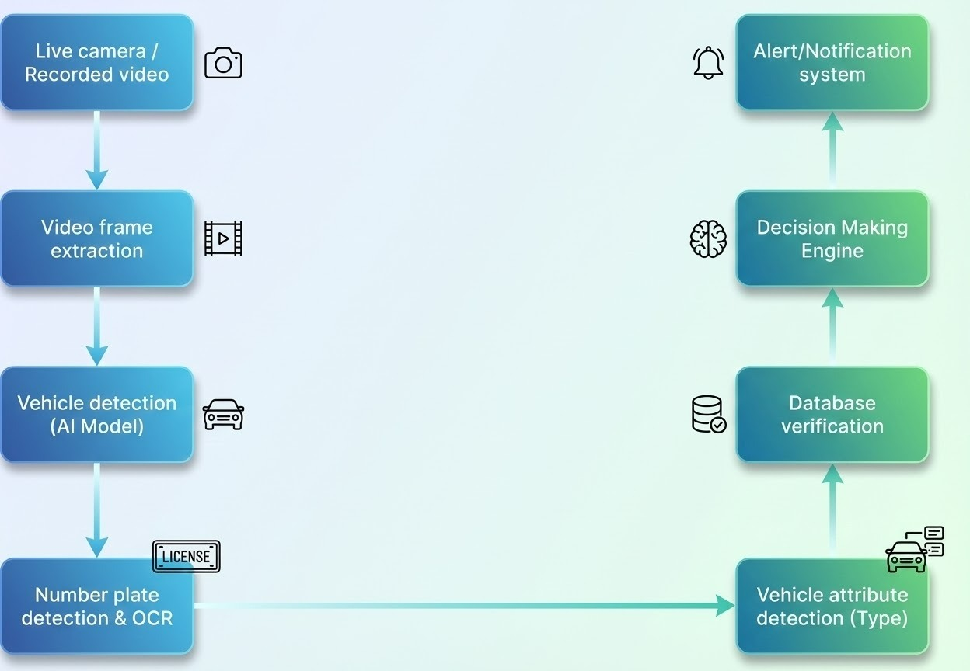
Basic Block Diagram

Slide 12
Project work plan
Stage 1: Video Acquisition & Frontend Interface
A web-based frontend is provided for user interaction
Users can upload recorded vehicle videos through the interface
System can also be integrated with live CCTV cameras at toll plazas
Selected video input is sent to the Python Django backend for processing
Stage 2: Video Frame Extraction
Input video is processed using OpenCV
Video is divided into individual frames at regular intervals
Extracted frames are forwarded for AI-based analysis

Slide 13
Project work plan
Stage 3: Vehicle Detection
YOLOv8 model is used to detect vehicles from extracted frames
Vehicles such as cars, bikes, buses, and trucks are identified
Detected vehicle regions are passed to subsequent modules
Stage 4: Number Plate Detection
Number plate regions are detected using a YOLOv8-based model
Detected plates are isolated from vehicle images
Plate images are prepared for text extraction

Slide 14
Project work plan
Stage 5: Vehicle Attribute Recognition
YOLOv8 model is used to identify vehicle attributes such as type
Attribute data is combined with number plate information
Enhances accuracy in vehicle verification

Slide 15
Software Requirements Specification (SRS)
Functional Requirements
FR-1: The system shall accept vehicle input through live or recorded video from the toll operator.
FR-2: The system shall detect vehicles and extract vehicle type and number plate using AI models.
FR-3: The system shall generate alerts when suspicious or predefined conditions are detected.
FR-4: The system shall display alerts to the toll operator and send them to the nearby traffic control room.

Slide 16
FR-5: The system shall store alert details including vehicle information, owner details, toll ID, location, date, and time.
FR-6: The system shall support multiple toll plazas using a centralized database.
FR-7: The system shall allow higher authorities (NHAI) to view alerts and vehicle details.

Slide 17
Non-Functional Requirements
NFR-1 (Performance): The system shall generate alerts in near real-time and support multiple toll plazas concurrently.
NFR-2 (Security): Access shall be restricted to authorized users, and sensitive data shall be protected.
NFR-3 (Reliability): The system shall operate continuously with reliable vehicle detection and alert generation.
NFR-4 (Scalability): The system shall allow the addition of new toll plazas without major changes.
NFR-5 (Usability & Maintainability): The system shall provide a user-friendly web interface and support easy maintenance and logging

Slide 18
Software And Hardware Requirements
Software Requirements
Operating System: Windows / Linux
Backend Framework: Python 3.x with Django
Database: MySQL
Frontend: HTML5, CSS3, JavaScript
AI Library: Ultralytics YOLO
Supporting Libraries/Tools:
OpenCV (for video processing)
Django ORM
NumPy

Slide 19
Hardware Requirements
Client-Side
Device: Desktop or laptop with modern web browser
Processor: Dual-core or higher
RAM: 2 GB minimum
Server-Side
Processor: Quad-core or higher
RAM: 8 GB or higher
Storage: SSD with sufficient space for video data and database
GPU: Optional but recommended for faster YOLO inference

Slide 20
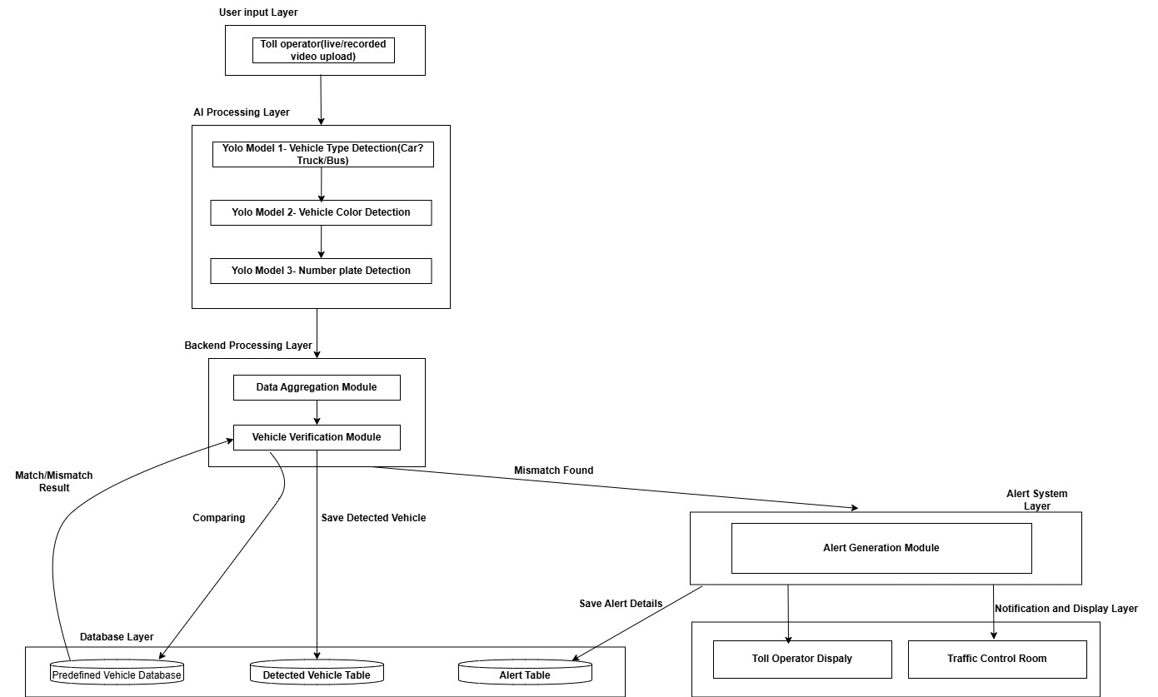
System Architecture

Slide 21
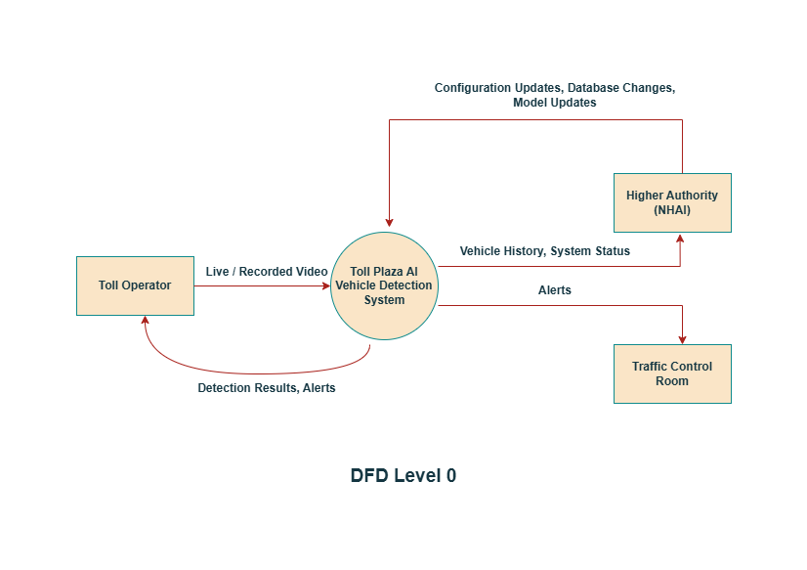
Data Flow Diagram

Slide 22
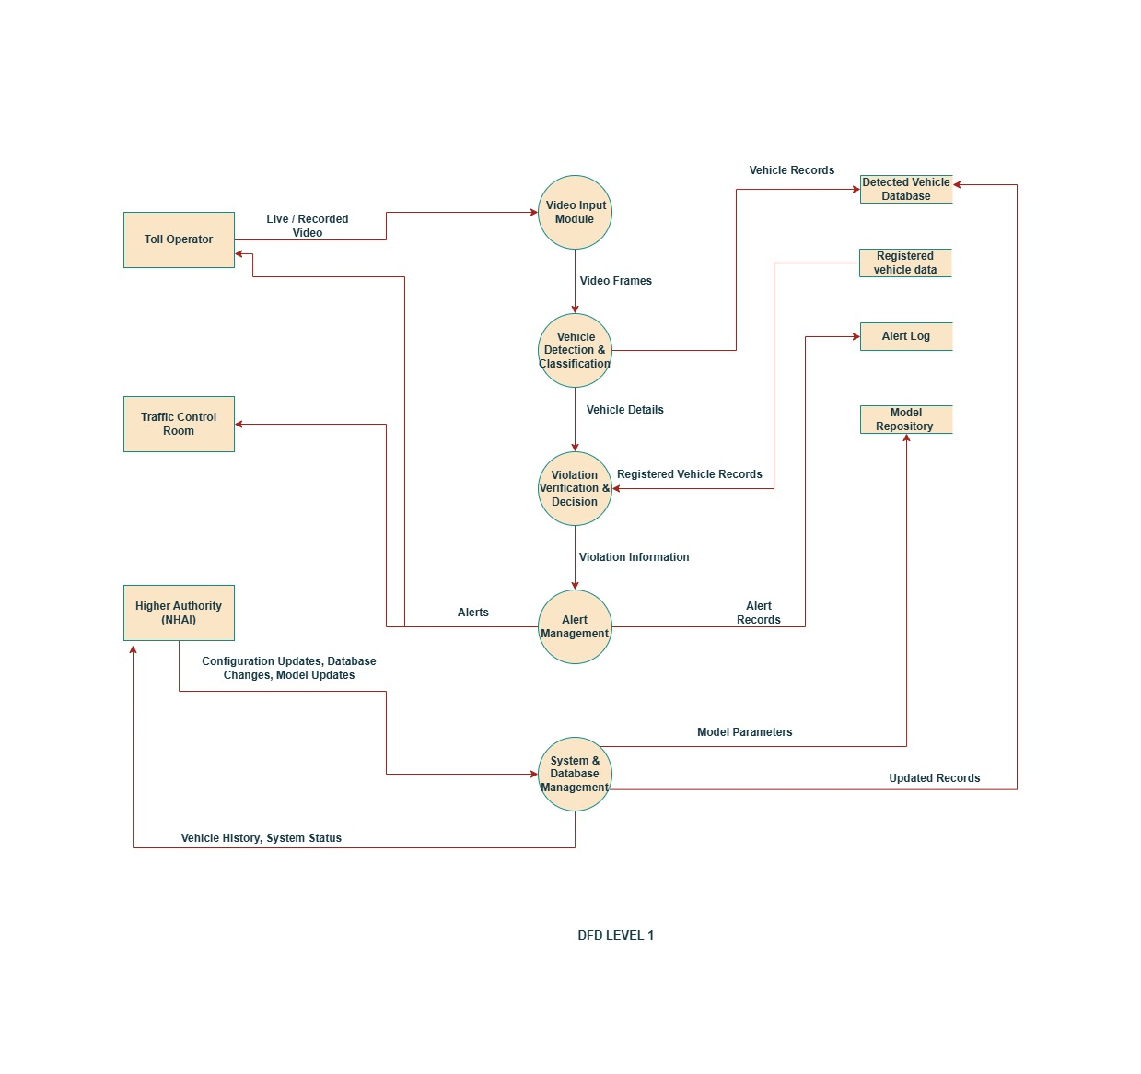
Data Flow Diagram

Slide 23
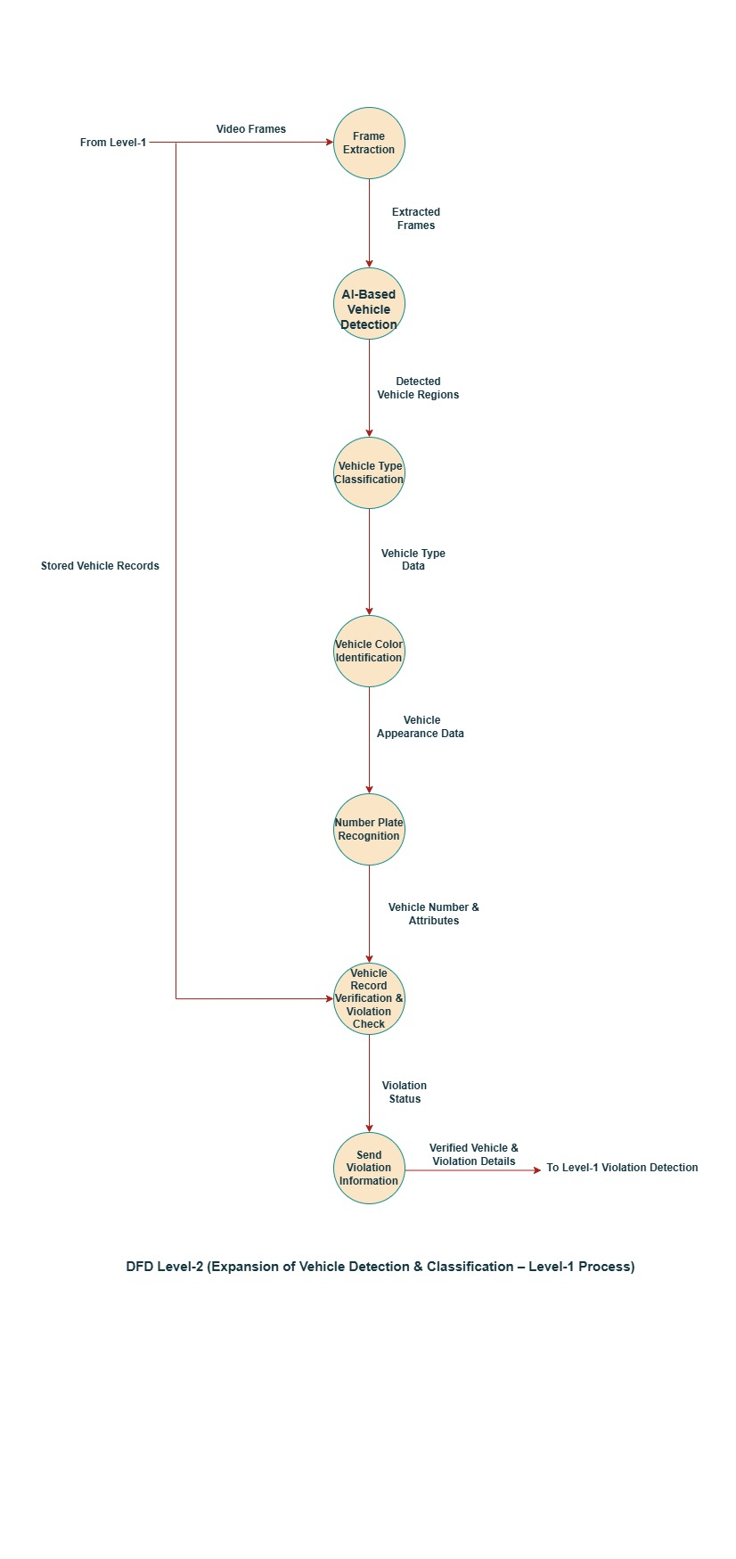
Data Flow Diagram

Slide 24
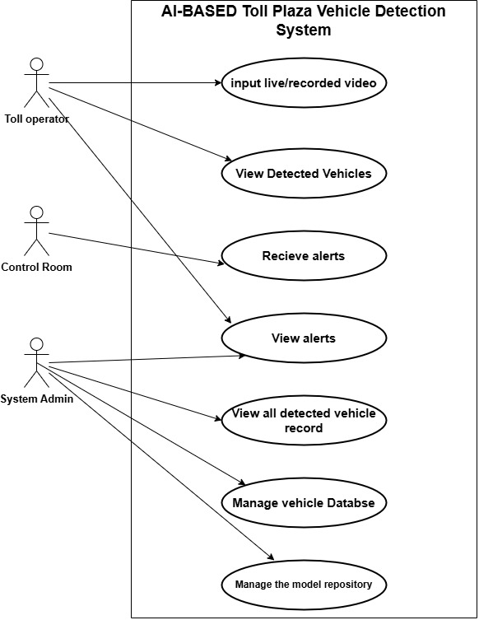
Use Case Diagram

Slide 25
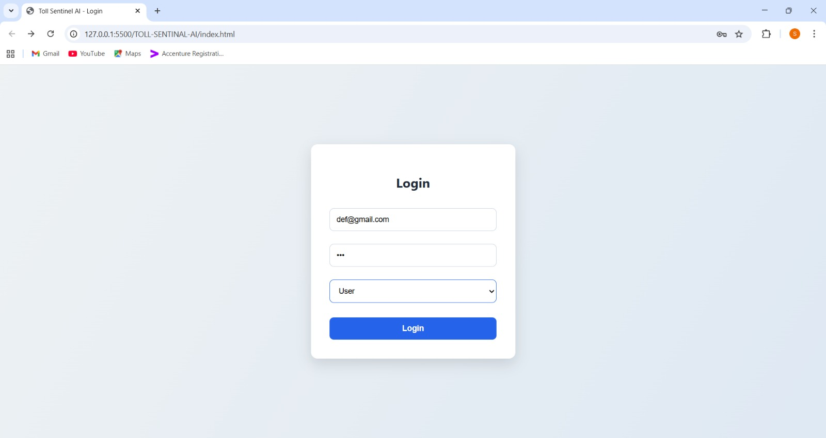
GUI Design
Toll operator

Slide 26
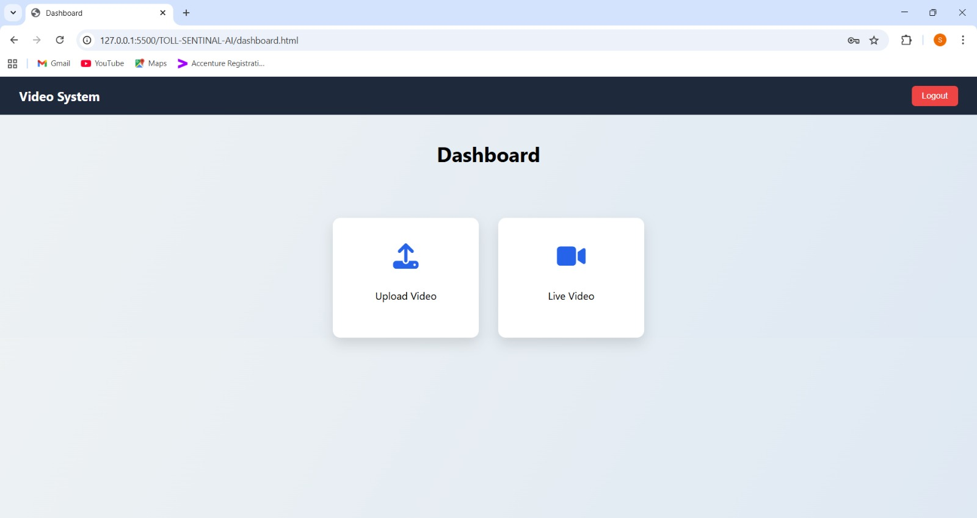

Slide 27
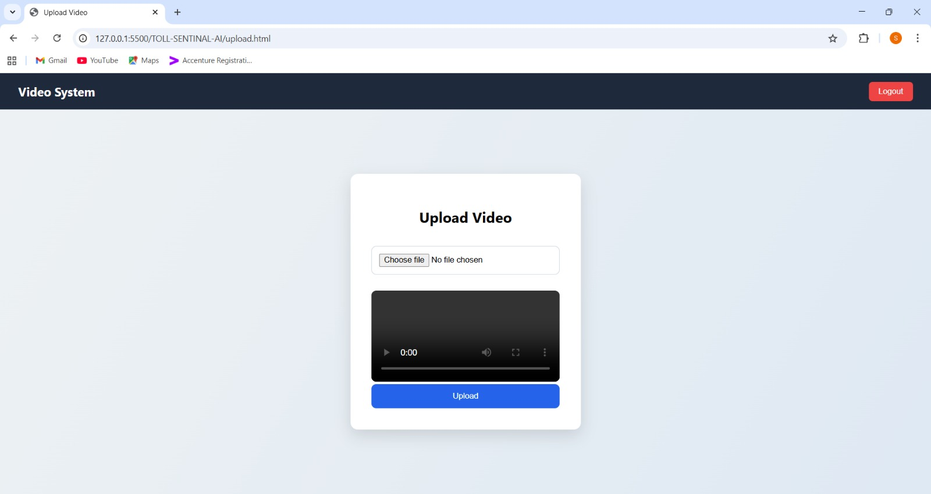

Slide 28
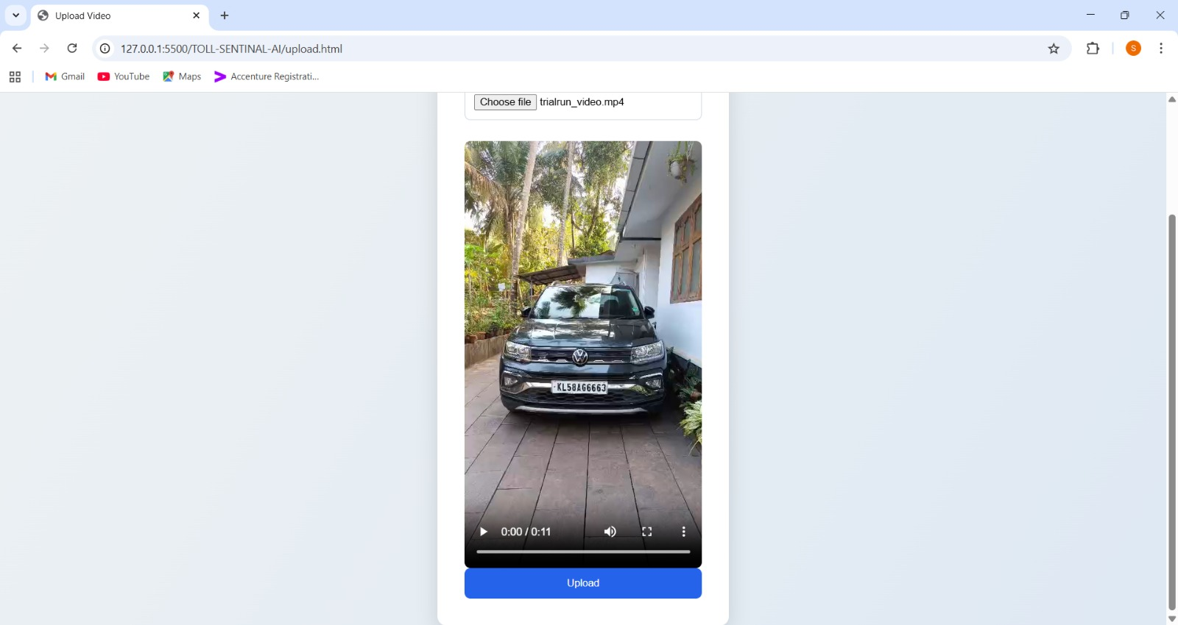

Slide 29
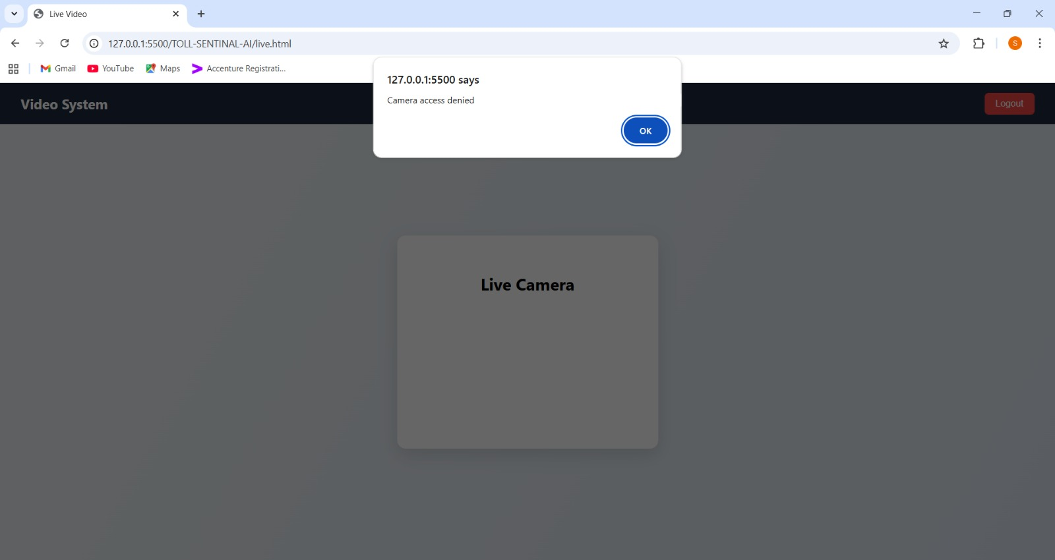

Slide 30
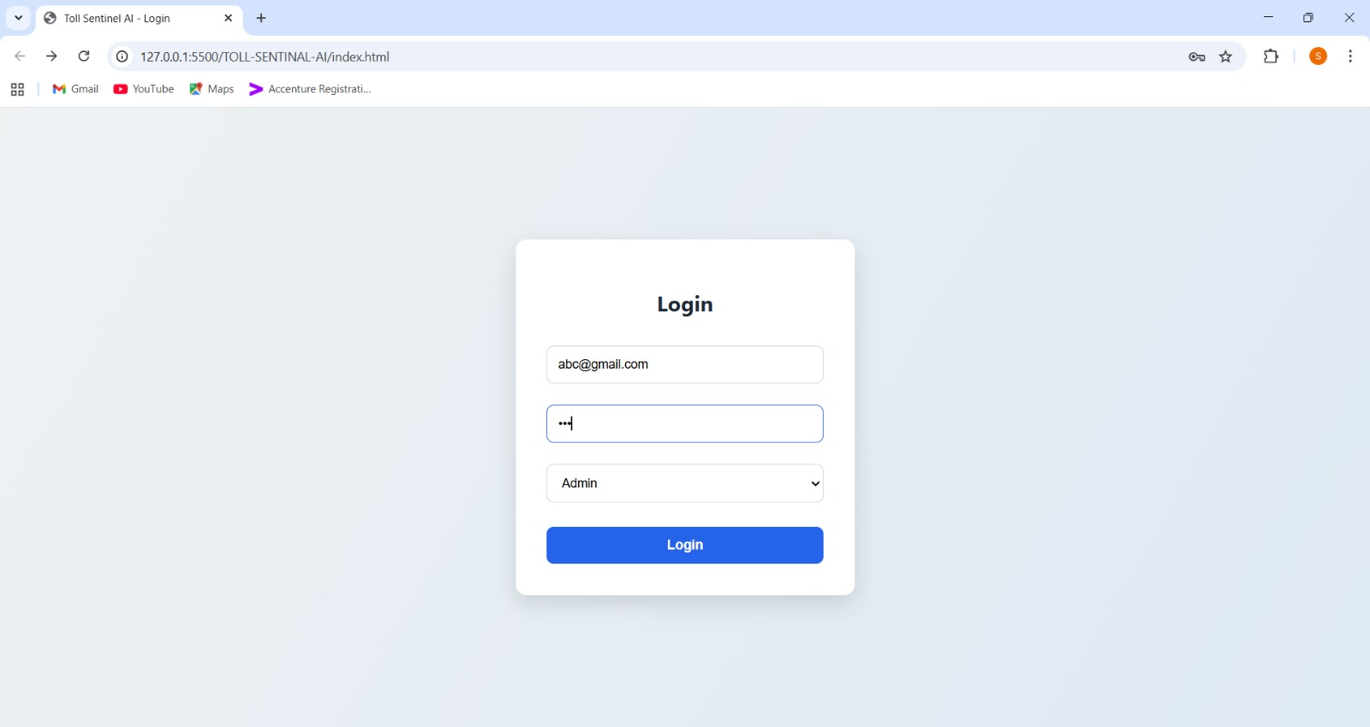
Admin

Slide 31
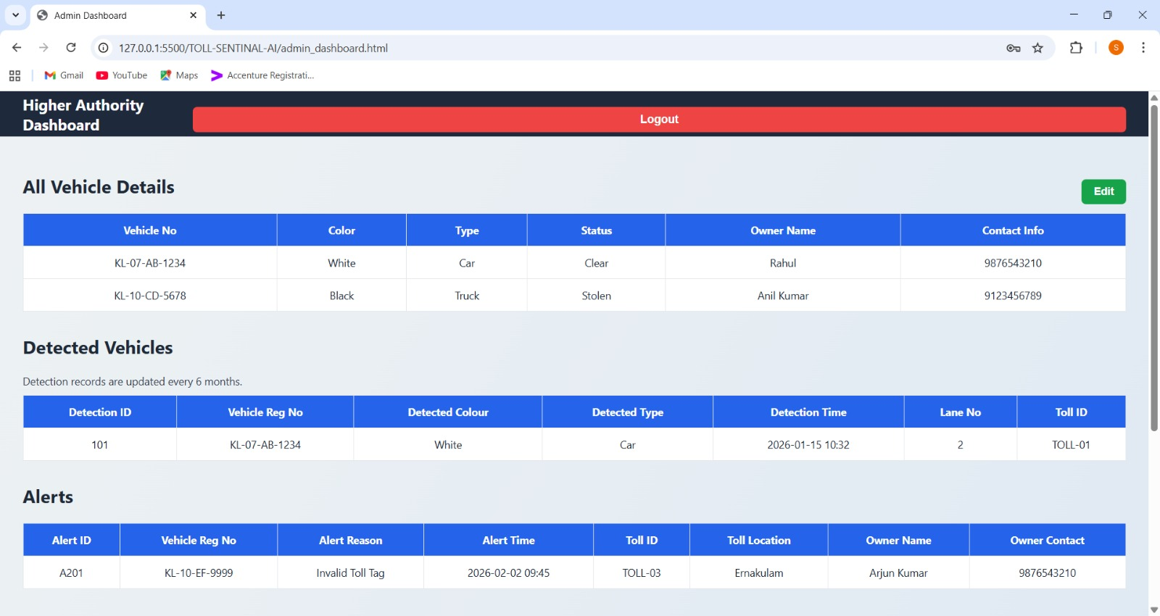

Slide 32
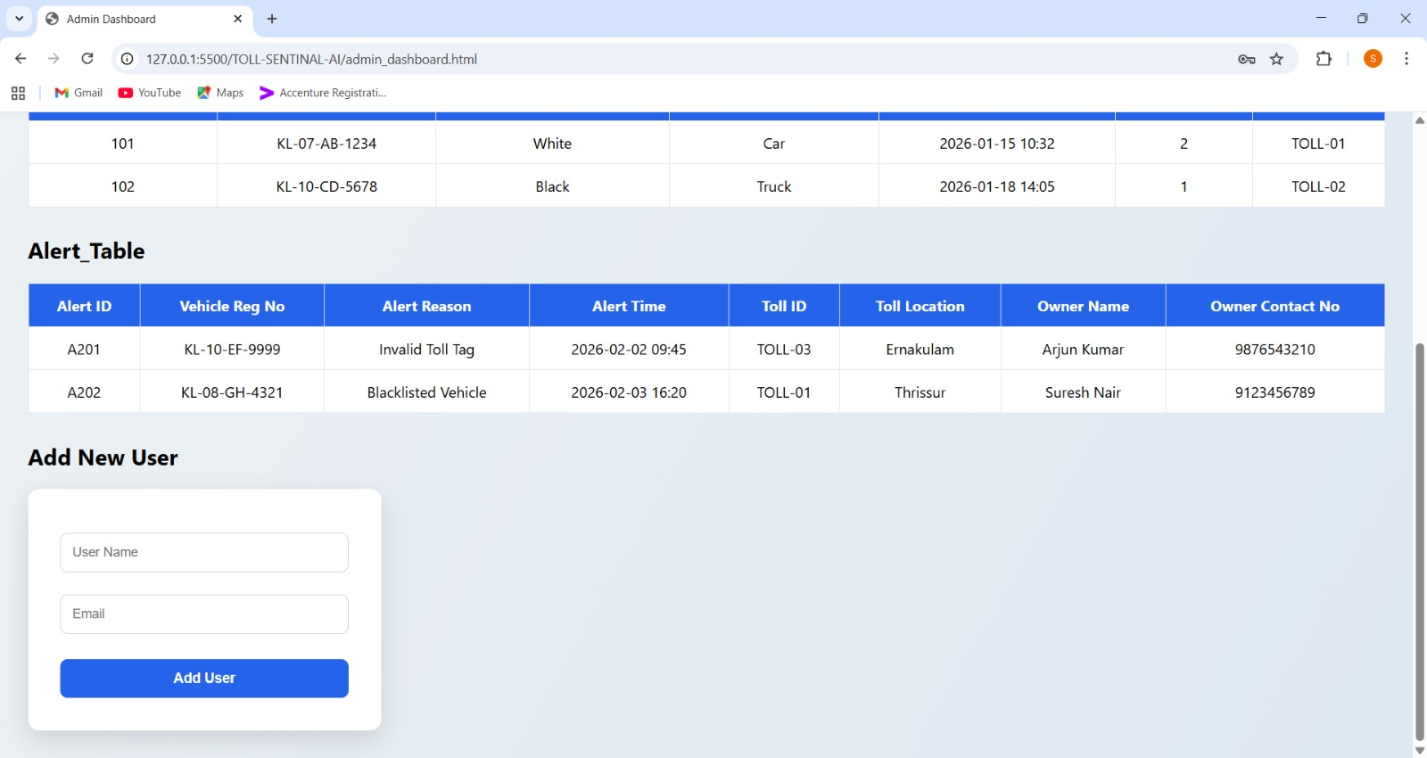

Slide 33
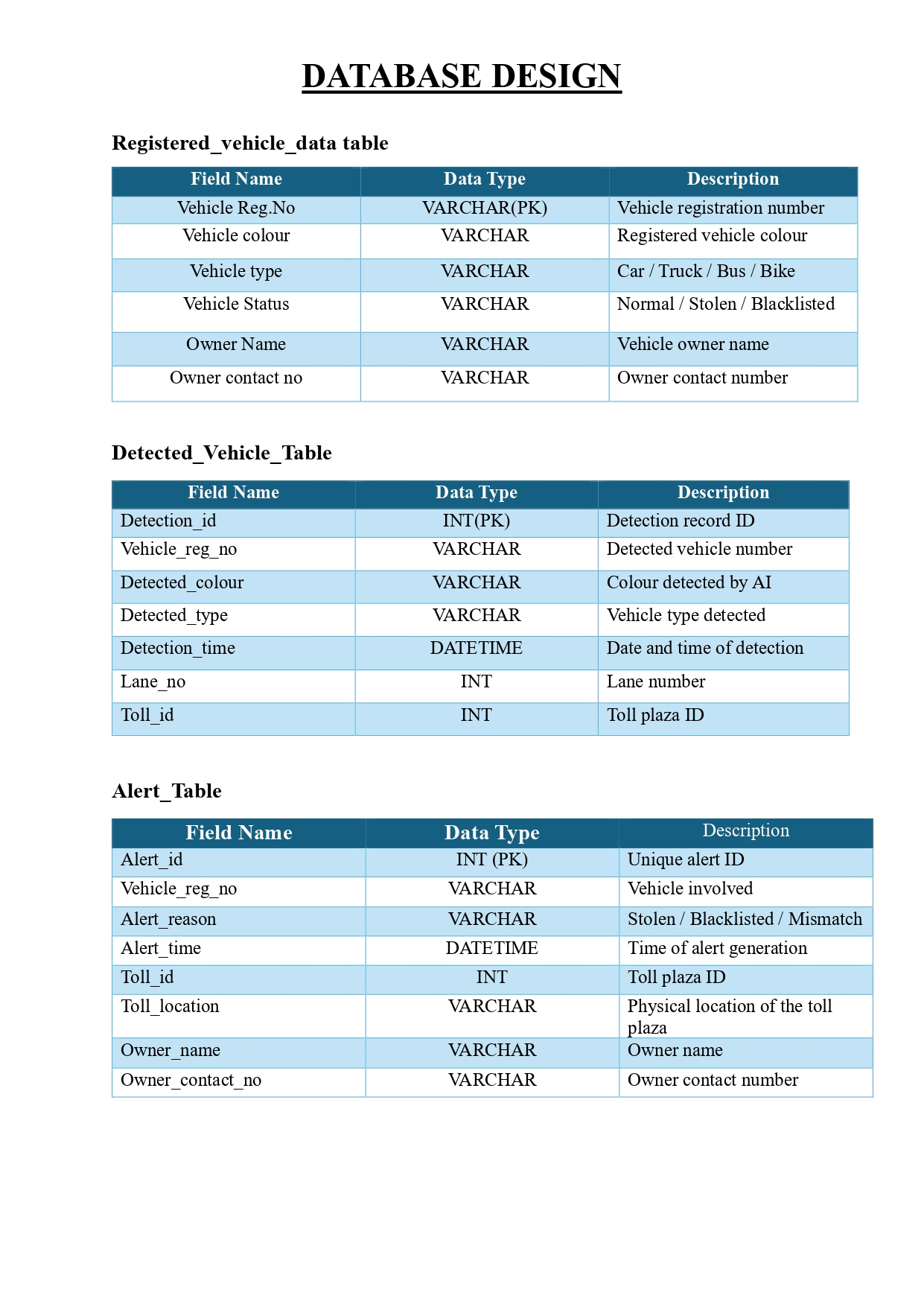
Database Design

Slide 34
SYSTEM MODULES
1. Front-End Module
Provides two separate login interfaces:
Toll Operator login
Higher Authority (NHAI) login
Toll Operator can:
Upload recorded video or use live camera feed
View detected vehicle details
View real-time alerts

Slide 35
NHAI can:
View alerts from all toll plazas
Add vehicles to the database
Edit vehicle details
Remove vehicles from the database
Implements role-based access control.
2. Back-End Module
Handles all requests from the front end.
Authenticates users and manages access roles.
Controls data flow between AI module, database, and alert system.

Slide 36
Performs vehicle verification logic.
Sends real-time alert data to the traffic control room.
3. AI / Vehicle Detection Module
Processes live and recorded video input.
Detects vehicles from video frames.
Extracts vehicle number plate details
Sends detected vehicle data to the back end in real time.

Slide 37
4. Database Module
Stores authorized / reference vehicle data (managed by NHAI).
Stores recently detected vehicle data for verification.
Supports fast data comparison.
Used for real-time processing, not long-term alert history.
5. Alert System Module
Generates alerts when suspicious or matched vehicles are detected.
Uses the latest verified vehicle data.
Sends alerts to:
Toll operator interface
Nearby traffic control room
Operates in real time.

Slide 38
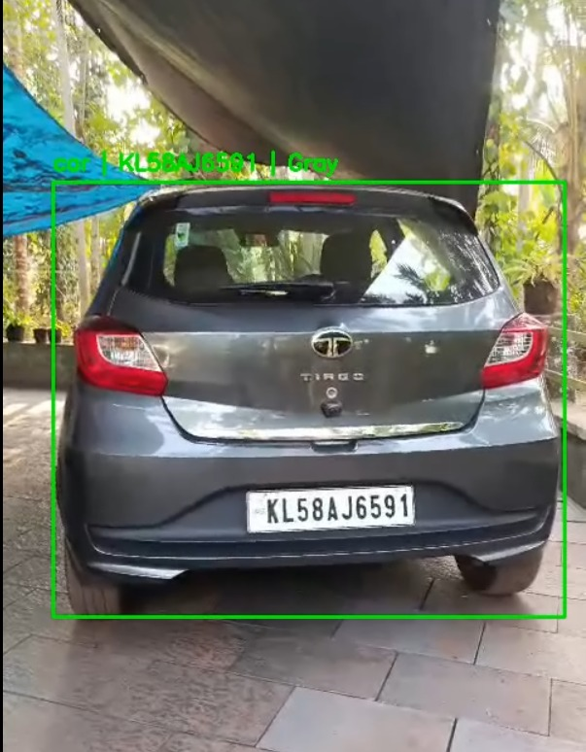
Demo images

Slide 39
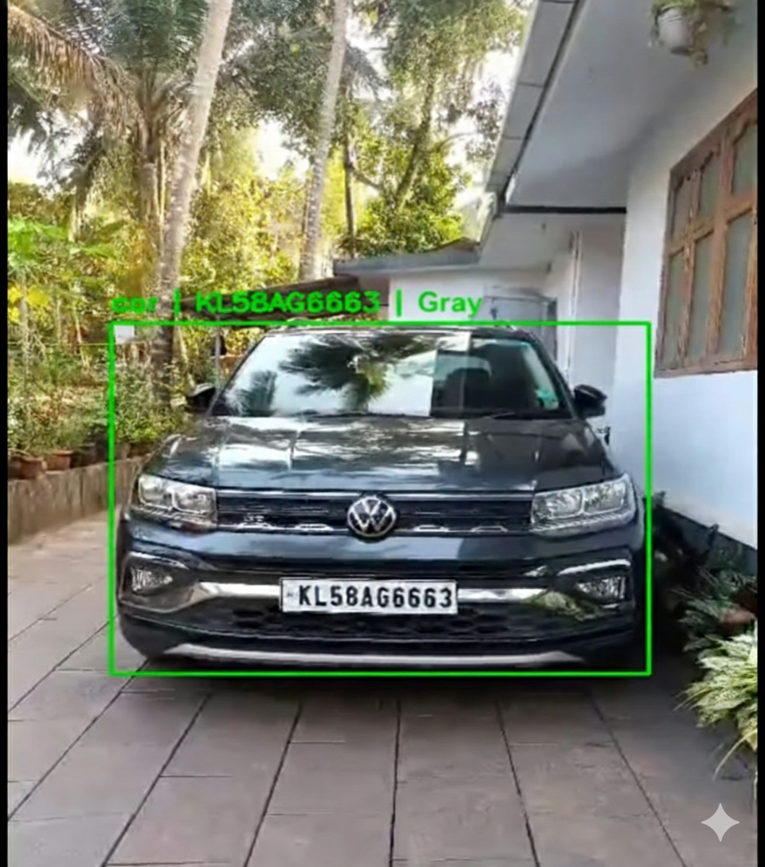
Demo images

Slide 40
Conclusion
The main objective of this project is to automatically detect vehicles at toll plazas using computer vision and artificial intelligence, verify them against a predefined vehicle database, and generate real-time alerts in case of mismatches, violations, or flagged vehicles.Currently, toll monitoring is largely manual and time-consuming. Our system aims to reduce human effort, improve accuracy, and enhance security by using YOLO-based vehicle detection, a Django backend, and a MySQL database.

Slide 41
References
[1] Shjarback, J. A., & Sarkos, J. A. (2025). An Evaluation of a Major Expansion in Automated License Plate Reader (ALPR) Technology. Justice Evaluation Journal, 1-18.
[2] Kumawat, K., Jain, A., & Tiwari, N. (2024). Relevance of automatic number plate recognition systems in vehicle theft detection. Engineering Proceedings, 59(1), 185.
[3] Mukaram Safaldin,Nizar Zaghden,Mahmoud MejdoubAn Improved YOLOv8 to Detect Moving Objects Jan 2024
[4] Aug 2024 Caixia Lv,Usha Mittal,vishu Madaan,Prateek Agrawal Vehicle detection and classification using an ensemble of EfficientDet and YOLOv8

Slide 42
References
[5] T. Azfar, J. Li, H. Yu, R. L. Cheu, Y. Lv, and R. Ke, “Deep learning-based computer vision methods for complex traffic environments perception: A review,” Data Sci. for Transp., vol. 6, no. 1, p. 1, Apr. 2024.
[6] Chughtai, B. R., & Jalal, A. (2024, February). Traffic surveillance system: robust multiclass vehicle detection and classification. In 2024 5th International conference on advancements in computational sciences (ICACS) (pp. 1-8). IEEE.

Slide 43
THANK YOU

